Slide 1
Post Graduate Student Union Learning is Fun with Arduino 2017-18
Session-1
Engr S M Asim Ali
School of Computer Science ,
Beihang University

Slide 2
Course Objectives
This course will have following objectives:
To seek basic knowledge about Arduino application in daily life
To get the knowledge of practical utilizations in home and industry
To develop a basic level automation using Arduino
To learn basic programming skills on Embedded Controller using Arduino IDE
To establish connectivity among different sensors and PC.
To control motors, power systems, relays etc

Slide 3
Course Contents
Understanding Basics of Embedded Controller
Interconnecting Arduino
Programming Arduino
Introduction to Arduino IDE
Interfacing Sensors
Optimizing Sensors & Inputs
DC Motors
Project

Slide 4
Course Outcomes
Be familiar with the history, concept development and key components of robotics technologies.
Be familiar with various robot sensors and their perception principles that enable a robot to analyze their environment, reason and take appropriate actions toward the given goal.
Understand and able to analyze and solve problems in spatial coordinate representation and spatial transformation, robot locomotion design, kinematics, motion control, localization and mapping, navigation and path planning.

Slide 5
Course Outcomes -2
Be able to apply and demonstrate the learned knowledge and skills in practical robotics laboratories and experiments.
Be able to design and implement a robotic project on a physical mobile robot platform, with tasks involving project specification, algorithm design, software programming, simulation and modelling, control and obstacle avoidance in a complex and interactive environment.
Enhancing communication skills through project report and seminar presentation

Slide 6
Classes Schedule
This course contains
4 Sessions
Each of 2 Hours long
Total 08 Hours
Session I
07 Dec 2017 (01 Hour Theory)
21 Dec 2017 (02 Hours Theory +Programming Basics)
28 Dec 2017 (02 Hours Practical)
15 Jan 2018 (02 Hours+ 01 Hour exam)

Slide 7
Course Overview
Session I
Introductory Class
Description
Projects Discussion
Value of Automation and Industrial requirements
Course Material
Basics of Robotics & Programming
Edmodo
http://www. sparkfun.com
http://www.instructables.com/

Slide 8
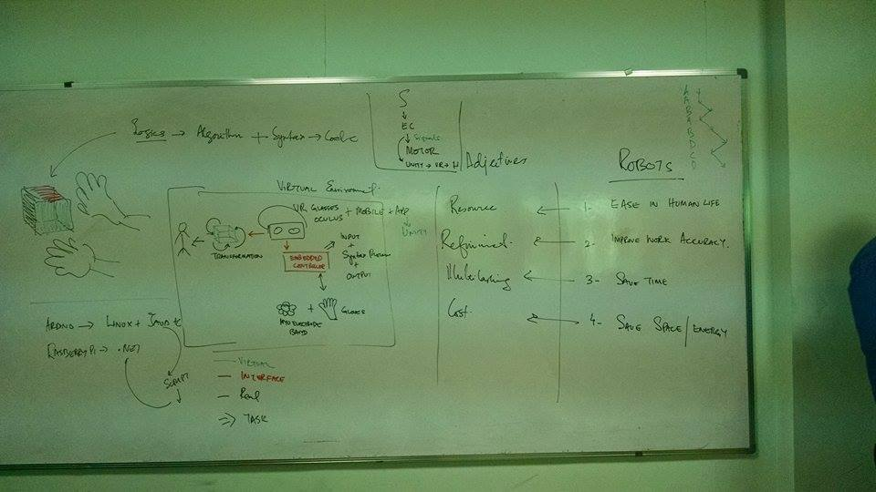
Lecture 1

Slide 9
Lab Material
To conduct a lab task, student need to download Arduino IDE from Arduino Official Site or use the link below
https://www.arduino.cc/en/Main/Software
All the necessary libraries according to hardware will be elaborated time to time and a support will be provided to download it from internet.
Hardware Arduino UNO or MEGA with 3 color RGB LEDs

Slide 10
Problem
In daily life, we face many problems like switching off fan when feeling cold, taking care of stove if leaving behind and even putting circuit off when water tank is full.
Do we have solutions
Servants
Self
Robots

Slide 11
How to Solve a Problem
Collect basic issue
Analyze the need
Design a cost effective solution
Implement in limited parameters
Testing
Deployment

Slide 12
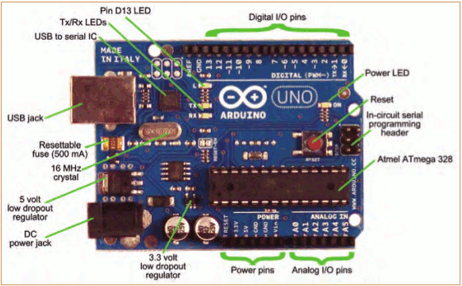
Meet the Controller that you need

Slide 13
Getting Started
Check out: http://arduino.cc/en/Guide/HomePage
Download & install the Arduino environment (IDE) (not needed in lab)
Connect the board to your computer via the USB cable
If needed, install the drivers (not needed in lab)
Launch the Arduino IDE
Select your board
Select your serial port
Open the blink example
Upload the program

Slide 14
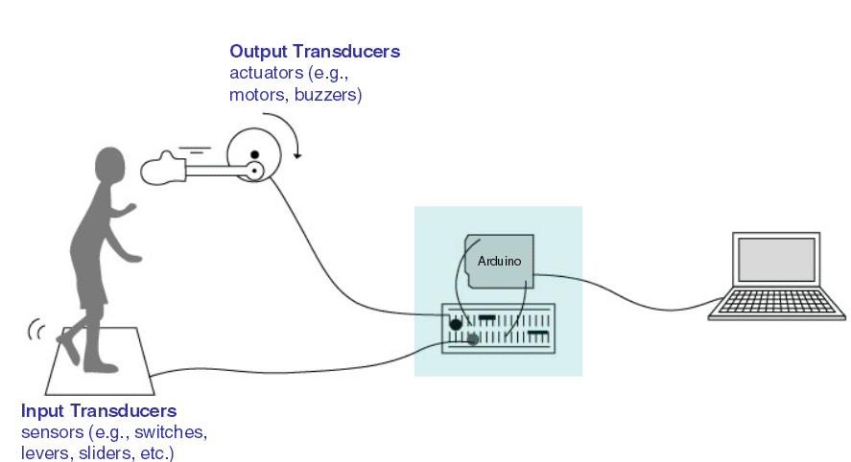
Man Machine Interface

Slide 15
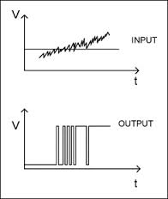
Binary Logic
Digital IO is binary valued—it’s either on or off, 1 or 0
Internally, all microprocessors are digital, why?

